Slide 1
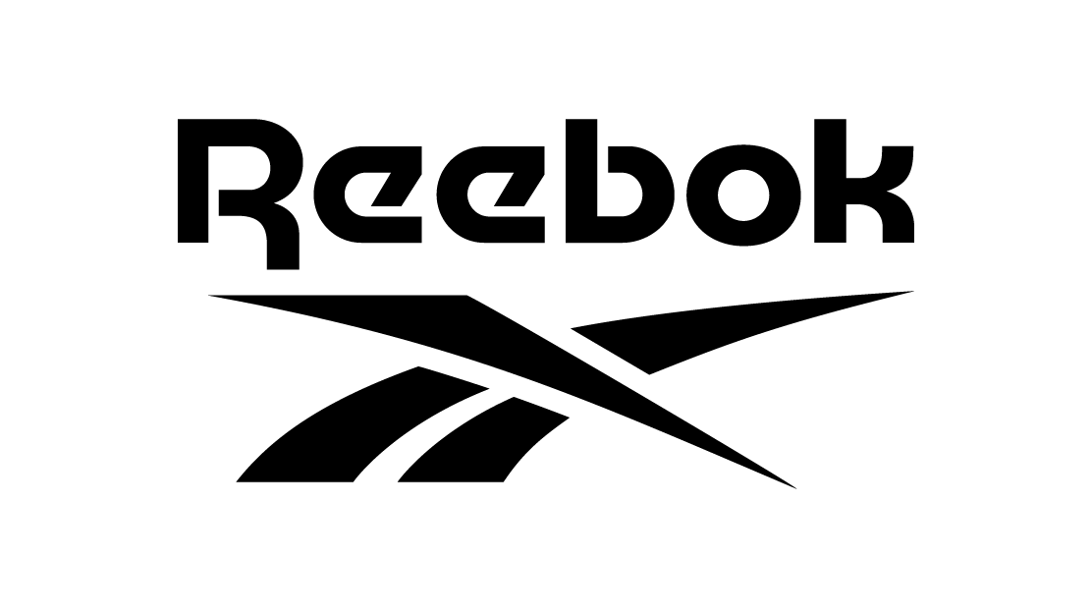
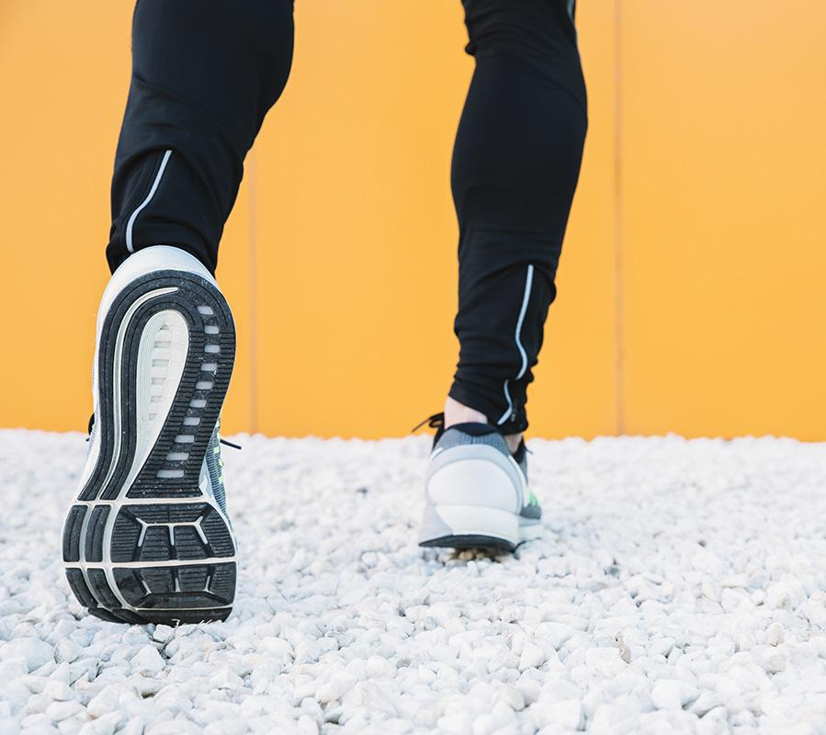
Reebok Revenue Enhancement Pitch
Go the extra mile.
Notes:
Hello and welcome to our presentation on how to enhance the revenue of Reebok.

Slide 2



Web Data Team 7
Deepa Narayanan
Dustin Allred
Quanqi Ke
Data Analyst
(Reebok)
Business Development
(Reebok)
Research Analyst
(Reebok)
Notes:
We are Team 7. The team consists of myself, Dustin focusing on Business Development, our Research Analyst Deepa, and our Data Analyst KK

Slide 3
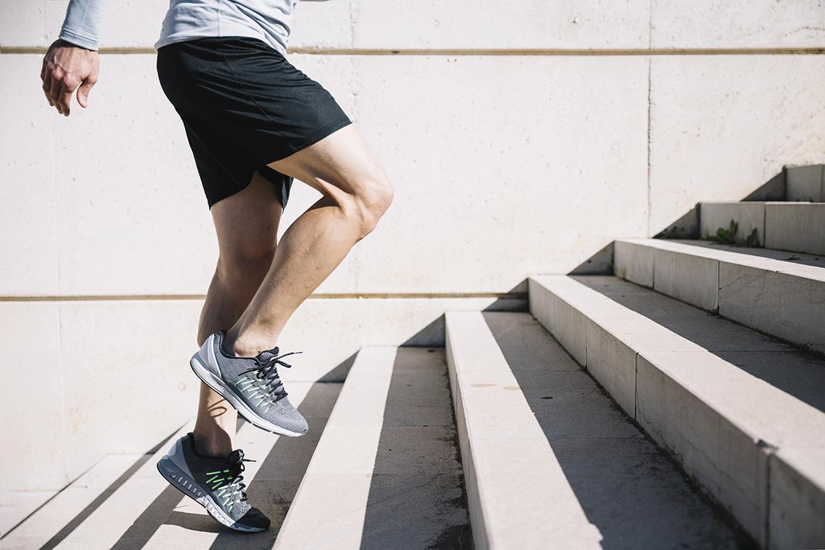
TABLE OF CONTENTS
01
02
03
04
History and The Business Problem
Reebok SWOT Analysis
Analysis Methodology
Competitor Analysis
Exploratory Data Analysis
06
Hypothesis Testing and Statistics
05
07
Key Takeaways
08
Recommendations
Notes:
In this presentation, I will be walking through the history of the Brand and introducing the Business Problem. KKwill then take us through a SWOT analysis and the Analysis Methodology, Deepa will then take us through a Competitor Analysis, Exploratory Data AnalysisHypothesis Testing and Key Takeaways, and finally deepa will finish up by giving our reccomendations

Slide 4
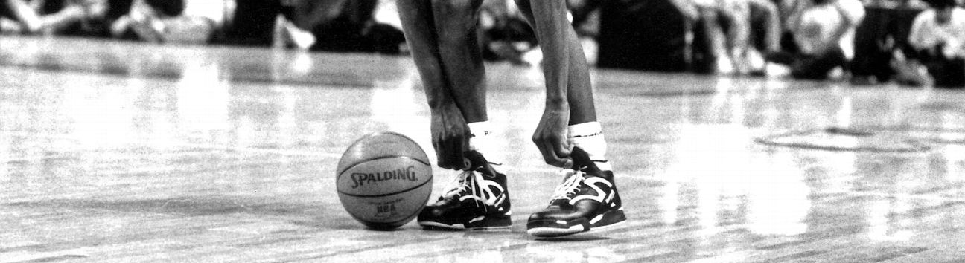
Reebok History
Reebok was founded in England in 1958 as a running shoe company
The company reached peak popularity in the US during the 90's and 00's with its basketball shoes
The company's popularity has consistently fallen since its peak
Adidas bought the company in 2005 for $3.8 billion and sold it in 2021 for 2.5 Billion
Reebok is now owned by Authentic Brands Group
Notes:
Reebok was founded in England in 1958 as a running shoe company
The company reached peak popularity in the US during the 90's and 00's with its basketball shoes
The company's popularity has consistently fallen since its peak
Adidas bought the company in 2005 for $3.8 billion and sold it in 2021 for 2.5 Billion
Reebok is now owned by Authentic Brands Group

Slide 5
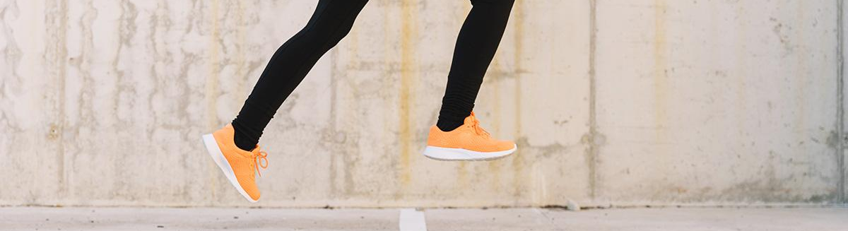
REEBOK'S BUSINESS PROBLEM
Reebok's popularity and market share have consistently dropped over the last 15 years
To address this, we are analyzing Reebok's current position in the market
We will be focusing on the consumer satisfaction metric
Notes:
Reebok has lost popularity with US consumers since it's peak at the turn of the century. Although revenues have increased, Reebok's market share has consistently dropped. In order to get Reebok back in the game, we wish to understand it’s current positioning in the market and avenues to level up the game to bring back it lost stature by improvising on the customer satisfaction metric.

Slide 6
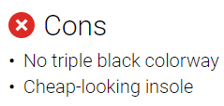

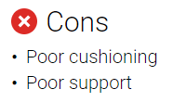

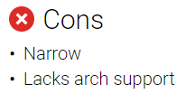


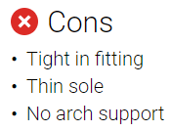
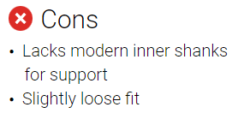
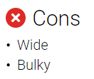
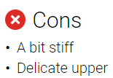
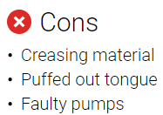

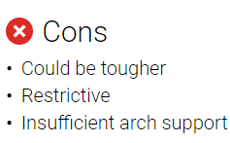
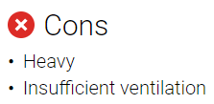

Current Pain Points for Reebok
Negative Customer Feedback from Reviews
UI/UX
Design
Notes:
We've created a cloud of negative feedback from customers to highlight areas where Reebok is currently struggling. As you can see, the performance of Reebok's shoes is an enormous issues with customers saying that the shoes don't have sufficient cushioning, or arch support. Customers also feel like the shoes are not supportive enough. I'll now

Slide 7

SWOT ANALYSIS (1/4)
STRENGTHS
S
W
Feature-rich products(selling point)
High customer engagement
Celebrity Endorsements
O
T
Notes:
https://www.marketing91.com/swot-analysis-of-reebok/

Slide 8

SWOT ANALYSIS (2/4)
WEAKNESSES
Poor awareness: customers only associate Reebok with sneakers.
Brand image: In the highly competitive sportswear segment, Reebok is no longer considered premium brand, but categorized alongside local or reginal players.
Lack of product variety: There are less options for consumers to choose from
S
W
O
T
Notes:
https://www.marketing91.com/swot-analysis-of-reebok/

Slide 9

SWOT ANALYSIS (3/4)
S
W
OPPORTUNITIES
New markets: Ethnic designs, women’s specialty sportswear and kids’ shoes.
Niche categories: combat shoes, dancing shoes, aerobics shoes or training shoes.
O
T
Notes:
https://www.marketing91.com/swot-analysis-of-reebok/

Slide 10

SWOT ANALYSIS (4/4)
S
W
THREATS
Competition: Nike, Adidas, Converse, New Balance and Puma
Cheap imitation: Customers looking for just the styling and not concerned about features may prefer the cheap imitations.
O
T
Notes:
https://www.marketing91.com/swot-analysis-of-reebok/

Slide 11
ANALYSIS METHODOLOGY
Performed Competitive Analysis
Web Scraping from RunRepeat
Data Pre-processing
Exploratory Data Analysis
Hypothesis Testing
Observations
Recommendations
1
2
3
4
5
6
7

Slide 12
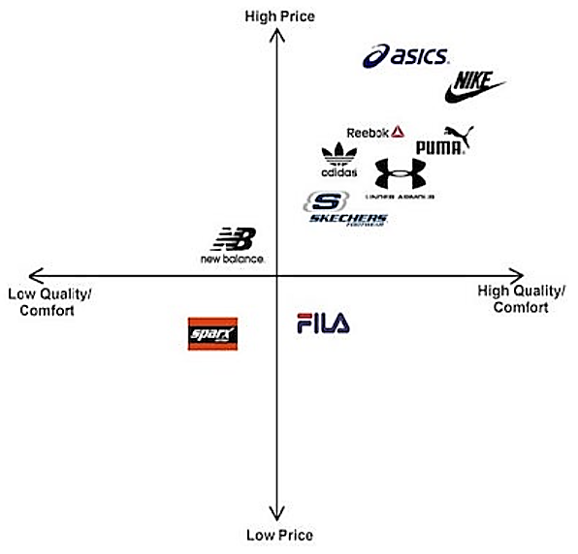
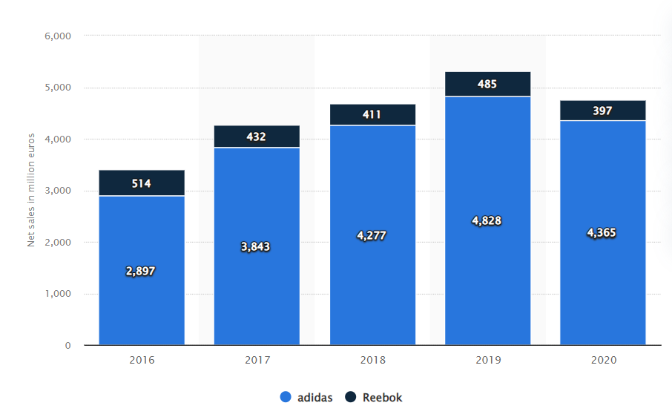
COMPETITOR ANALYSIS
ADIDAS
A stronger presence across teams, athletes, events, and leagues.
Adidas as a multi-sport specialist and a globalized market brand.
Variety of options when it comes to categorizing (13) shoes which helps customizers choose the one for customized activity. Eg: basketball, running, cycling, sneakers, training …etc.
Priority customer service for fast support anywhere.
Notes:
We performed the market positioning analysis to understand where Reebok stands as of today. It’s looked upon by the mid-segment audience who prefer a sweet balance between quality and pricing over the brand value.
As a subsidiary of Adidas , Reebok has for a long time been prominent in sporting arenas both locally as well as internationally as a formidable USA athletic shoe maker.
Reebok is now more squarely focused on the fitness market, a much smaller space than the sports world it used to operate in.

Slide 13
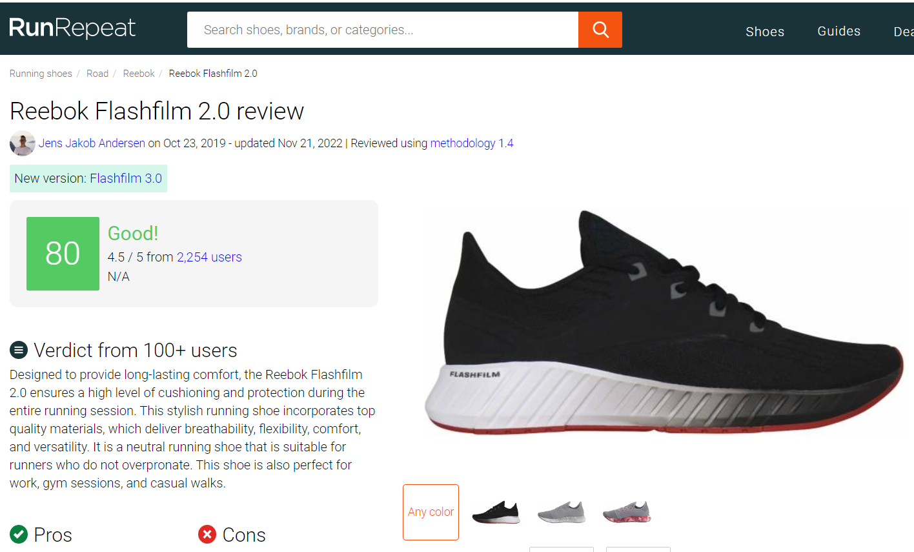
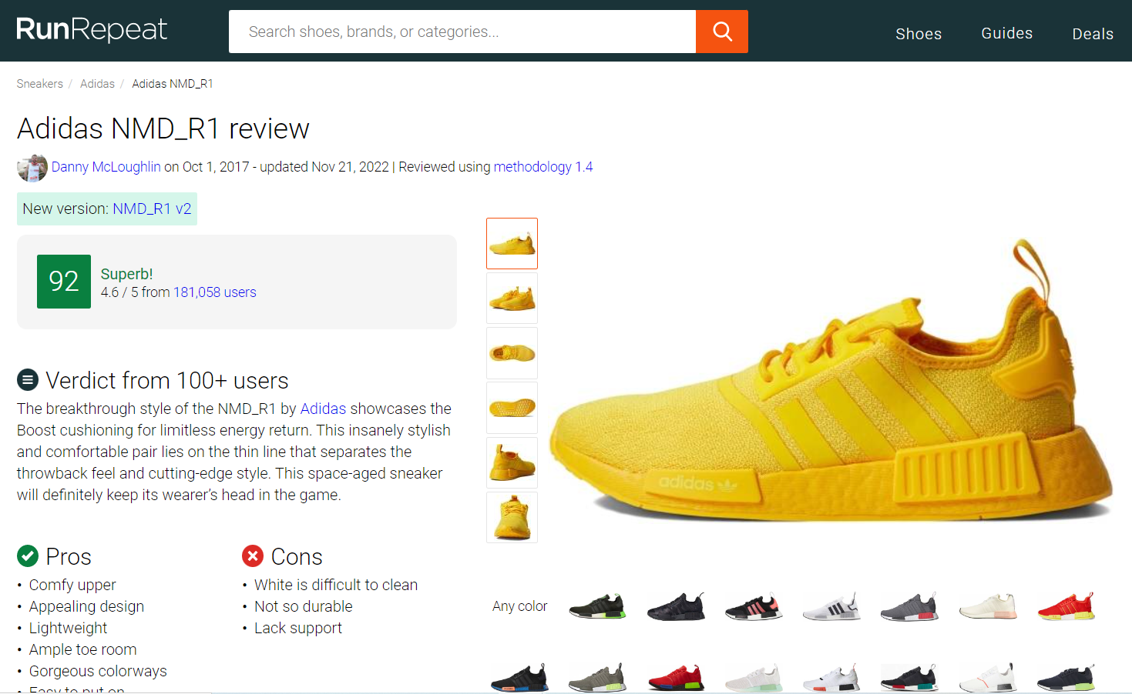
COMPETITOR ANALYSIS - RunRepeat
RUN REPEAT
RunRepeat is run by geeks. For each shoe, they spend 15 to 30 hours to research technologies, upgrades, read user and expert reviews and run in the shoes.
Each athletic shoe and sneaker gets a score from 1-100 called the CoreScore. The higher the score, the better the reviews.
Notes:
RunRepeat.com is an ad free and cost free website driven by a community of runners that review running shoes at the website. It has more than 100,000 user reviews and 2,500 expert reviews miking it a reliable platform to compare how each brand is performing at their capacity

Slide 14
COMPETITOR ANALYSIS - RunRepeat
Basic Statistics of Attributes
Brand Availability by Category
Brand Product Score and User Rating
Column | Description
Brand | Data extracted for Reebok and Adidas
Product Name | Product Name (SKU)
Product Score | CoreScore provided by RunRepeat
Review Count* | Frequency of feedback received
Product Price | Price of product
Category | Product classification based on purpose
User-Review | Average rating by users for product
Category- Product Count | Adidas | Reebok | Grand Total
sneakers | 84 | 13 | 97
running-shoes | 1 |  | 1
training-shoes | 9 |  | 9
hiking-shoes | 23 |  | 23
soccer-cleats | 13 |  | 13
golf-shoes | 24 |  | 24
basketball-shoes | 179 | 50 | 229
walking-shoes | 398 | 104 | 502
hiking-boots | 76 |  | 76
tennis-shoes | 14 |  | 14
football-cleats | 17 |  | 17
track-and-field-shoes | 34 | 80 | 114
cycling-shoes | 1 | 15 | 16
Grand Total | 873 | 262 | 1135
Total Reebok Products = 262
Total Adidas Products = 873
Average Product Score = 85.6273
Average Review Count = 7816.11
Total Categories = 13
Average User Rating = 4.4
Top 5 in-demand categories (Based on Review Count):
Sneakers
Running-shoes
Training-shoes
4. Hiking-shoes
5. Soccer-cleats
* Associating Review Count to Demand
Notes:
We extracted data points like User Review, Product Score (A scoring metric defined by the RunRepeat experts), Pricing and category to analyze which can be the area of improvement for Reebok.
Here, we have associated Review Count to a pseudo demand metric.
Upon analysis we found that the footwear market is in demand for sneaks, running shoes, training shoes, hiking shoes and soccer cleats.

Slide 15
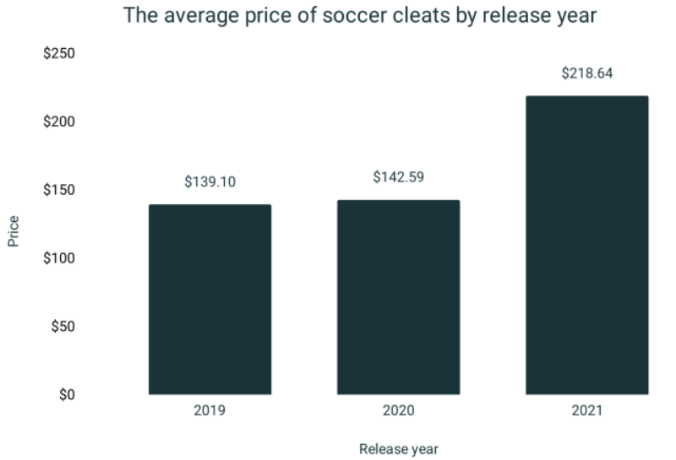
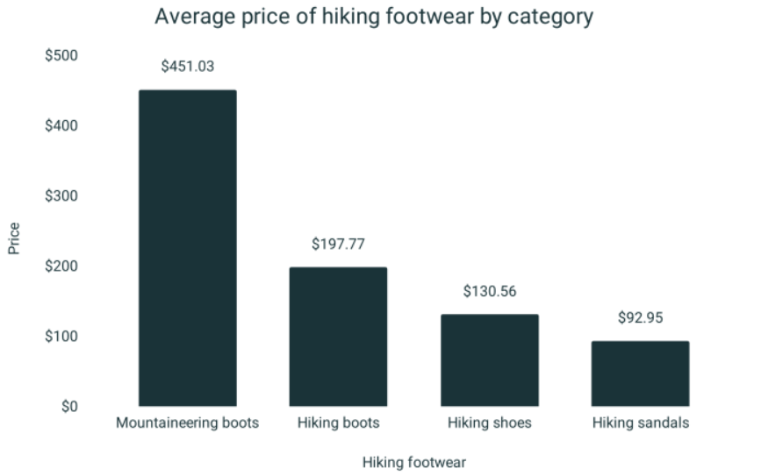
PRODUCT CATEGORY ANALYSIS
Avenues to improve customer satisfaction:
Out of the 5 in-demand categories, both Reebok and Adidas produce shoes in these 3 categories:
running-shoes, sneakers and training-shoes
Opportunity for new products:
Out of the 5 in-demand categories, Adidas alone produces shoes in these 2 categories:
hiking-shoes, soccer-cleats
Avenues to improve customer satisfaction:
Out of the 5 in-demand categories, both Reebok and Adidas produce shoes in these 3 categories:
running-shoes, sneakers and training-shoes
Opportunity for new products:
Out of the 5 in-demand categories, Adidas alone produces shoes in these 2 categories:
hiking-shoes, soccer-cleats
Adidas | Adidas | Reebok | Grand Total
running-shoes | 4.44 | 4.35 | 4.42
sneakers | 4.50 | 4.43 | 4.49
training-shoes | 4.50 | 4.42 | 4.45
Grand Total | 4.48101473 | 4.410683761 | 4.461538462
Adidas | Average of UserReview | Sum of ReviewCount | Average of ProductPrice
hiking-shoes | 4.38 | 178237 | 88.79
soccer-cleats | 4.37 | 158815 | 102.49
Grand Total | 4.372 | 337052 | 99.2
The average MSRP price of soccer cleats is $148.86 while the average available lowest price is $100.70
The average MSRP price of a pair of hiking shoes is $177.67 while the average available lowest price is $122.66
Notes:
Clearly the figures narrate that Reebok needs to improvise in the 3 out of top 5 in demand categories and most importantly tap the potential to expand their precense in hiking shoes and soccer cleats which see an average pricing range of 120-170 $ and 100-150$ respectively

Slide 16
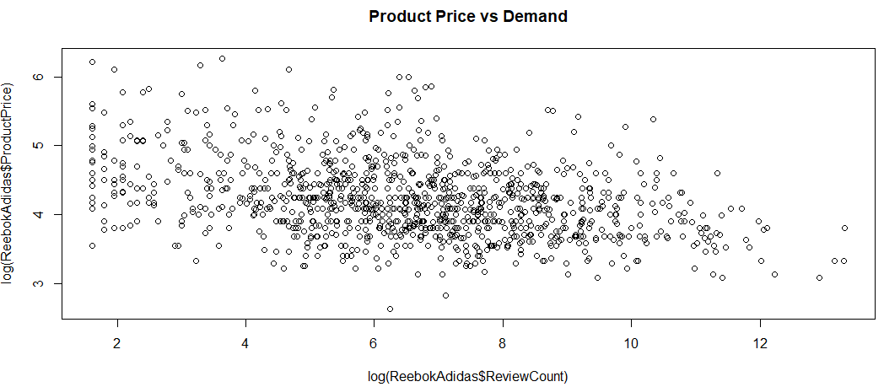
HYPOTHESIS TESTING OUTCOME
Log(ReviewCount) = 1.474713 -2.044574log(ProductPrice)+0.297614ProductScore-2.878416UserReview+0.063404ProductPrice+0.608054factor(Category)cycling-shoes-0.630676factor(Category)football-cleats+1.109861factor(Category)golf-shoes+2.589731factor(Category)hiking-boots+2.119563factor(Category)hiking-shoes+1.548937factor(Category)running-shoes-0.240464factor(Category)sneakers+0.671178factor(Category)soccer-cleats+1.451665factor(Category)tennis-shoes-1.311565factor(Category)track-and-field-shoes+0.930682factor(Category)training-shoes+0.069466factor(Category)walking-shoes
* With 99.9 % confidence we can claim that the following observations are statistically weighty, at a significance level of 0.001 considering all other parameters are held constant
* With 90% confidence we can claim that this observation is statistically weighty at a significance level of 0.01 considering all other parameters held constant.
1 unit increase in Hiking Shoes, will increase the demand by 732.747%
1% increase in Product Price, will impact the demand by -2.04% considering all other parameters are held constant.
1% increase in Product Price, will decrease the demand by 2.04%
1 unit increase in soccer cleats, will increase the demand by 95.61%
Notes:
https://runrepeat.com/average-price-soccer-cleats
exp(2.11956) – 1*100
A change in X by one unit (∆X=1) is associated with a (exp(B1) - 1)*100 % change in Y
On performing a linear modelling we found that demand is affected by following attributes greatly:
(Call out the pointers)
Reebok should clearly focus on the midsegment portion where mid price segment and demand match

Slide 17
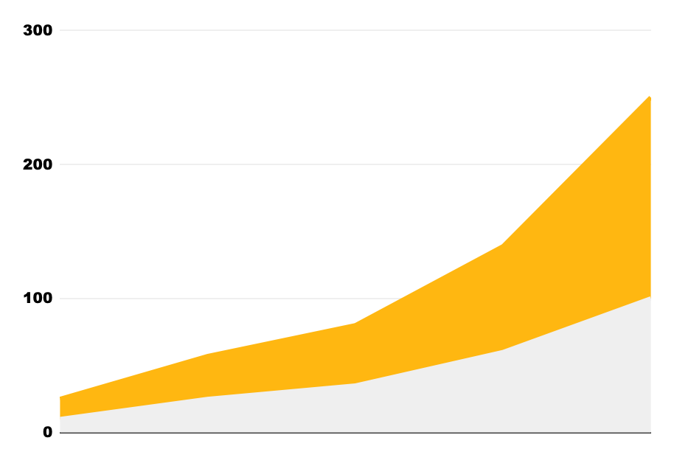
REVENUE GAIN
The Global Football Shoes Market size is expected to reach $24.5 billion by 2028, rising at a market growth of 5.4% CAGR during the forecast period
The global hiking footwear market reached a value of about USD 18.7 billion in 2021. The market is further estimated to grow at a CAGR of 3.30% in the forecast period of 2023-2028 to reach a value of around USD 22.9 billion by 2027.
Currently Reebok owns 1.1% market share in sports footwear space and is currently valued at $2.3B
Considering the brand image and market competition approximating the market share to 0.55%, in the soccer and hiking footwear presence, Reebok can aim to capture a value of 0.1347B + 0.1259B = 0.2606B
This will amount to a 11.3% increase in revenue.
Notes:
Reference:
https://www.expertmarketresearch.com/reports/hiking-footwear-market
https://www.grandviewresearch.com/industry-analysis/football-shoes-market-report
https://www.zippia.com/reebok-careers-36378/revenue/#:~:text=Reebok%20revenue%20is%20%242.3B,was%20%242.3B%20in%202021.
Considering a safe bet of half of the current market share of 1.1% that Reebok currently holds at overall, we see soccer footwear can contribute 0.1347B and 0.1259 in hiking footwear
This will account for 11.3% rise in revenue valuation for the company

Slide 18

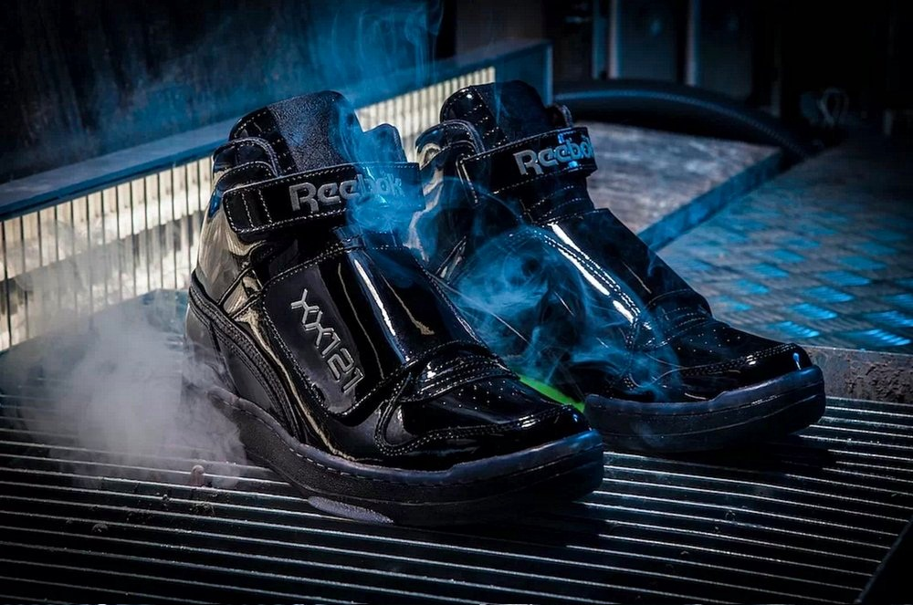
KEY TAKEAWAYS
There is a significant difference in User Rating for Adidas and Reebok.
Soccer cleats and hiking shoes contribute to 51% of the total demands and adidas is investing a good section in this zone.
Sneakers contribute towards 69.05% of total footwear sold by Reebok followed by training-shoes (22.54%)

Slide 19

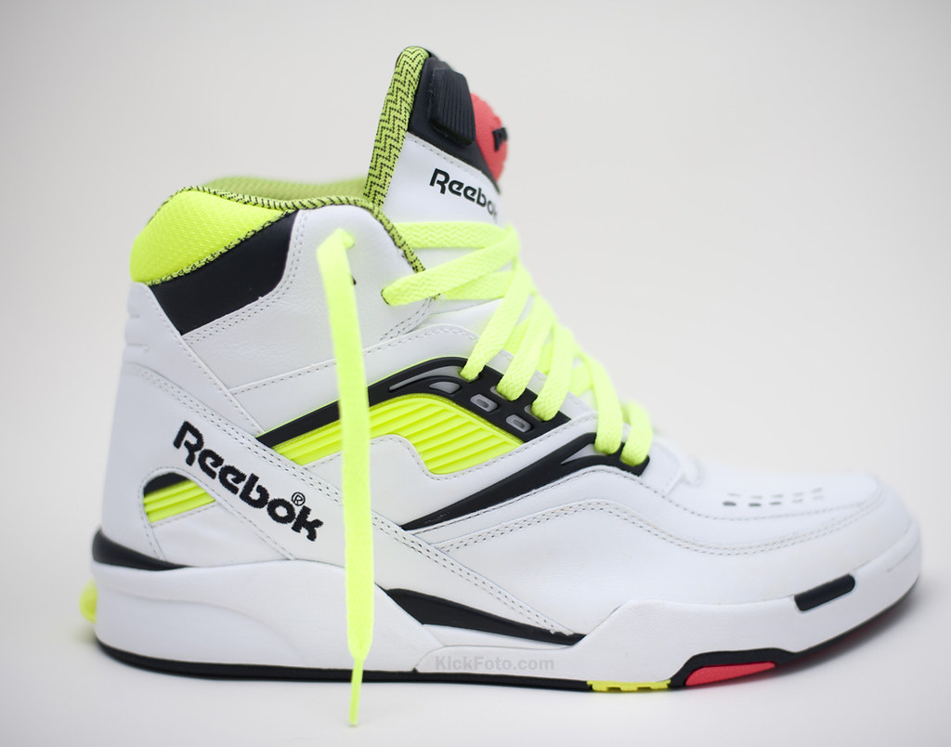
RECOMMENDATIONS
Converting the weakness from SWOT Analysis to source of opportunities:
Extend the product variety: open product line for soccer cleats and hiking shoes will increase the product variety as well as increasing sales and customer rating.
Pricing a little lower than Adidas: Using the competitive pricing strategy, we can target the price for hiking shoes around $75, and soccer cleats around $90, so Reebok can be more competitive in the market.
Sneakers improvisation: Because this is a mid-segment wear, quality is not given much priority over looks as it’s for casual use. Reebok should focus on the UI/UX improvisation as it already holds a good market share in this segment.
Notes:
Similar Product functionality
Unique design technique: Flies (Followed by Nike), Velcro, Slipons (causal walking shoes) which can be priced marginally high due to their unique functionalities.

Slide 20
LIMITATIONS
As we did not have data for demand / sales, we have assumed the review count as a pseudo quantity for demand.
In absence of historic revenue data the forecasting done for pricing strategy can be less accurate as it is based on a holistic market share percentage.
Lack of revenue data at Category level for Reebok and Adidas limits the scope of predicted category level gains (esp: Sneaker).

Slide 21
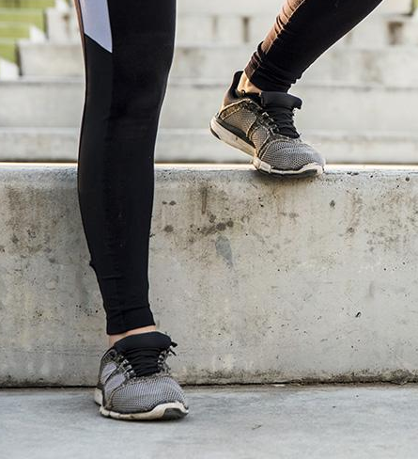
THANKS!

